Slide 1


Lecture 9: Memory Mapped Inputs and Outputs
and Simple Peripherals
.

Slide 2
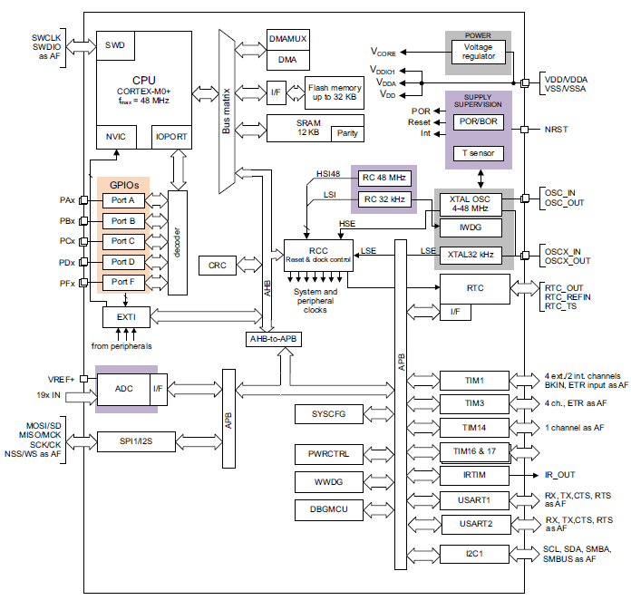
Overview of Lecture
What Are Peripherals?
Memory Mapped I/O
General Purpose Inputs/Outputs
Light Emitting Diodes (LEDs)
Switches
Keypads
Liquid Crystal Displays (LCDs)

Slide 3
ARM Microcontroller Block Diagram
CPU

Slide 4
ARM Microcontroller Block Diagram
Memory
CPU

Slide 5
ARM Microcontroller Block Diagram
Memory
CPU
Peripherals

Slide 6
What Is a Peripheral? Something That Helps the CPU

Slide 7
What Is a Peripheral?
1. They do something that the CPU does not want to do
Assist a microcontroller CPU by doing some activity in parallel to the CPU's execution of instructions

Slide 8
What Is a Peripheral?
1. They do something that the CPU does not want to do
Assist a microcontroller CPU by doing some activity in parallel to the CPU's execution of instructions
2. Do things that a microcontroller CPU cannot do
The CPU is a self-contained, digital logic block. There are some things that the CPU just cannot do without help.

Slide 9

Embedded Systems Challenges
Small Size, Low Weight
Hand­held electronics
Transportation applications weight costs money
Low Power
Battery power for 8+ hours (laptops often last only 2 hours)
Limited cooling may limit power even if AC power available
Harsh environment
Heat, vibration, shock
Power fluctuations, RF interference, lightning
Water, corrosion, physical abuse
Safety-critical operation
Must function correctly
Must not function incorrectly
Extreme cost sensitivity
$0.05 adds up over 1,000,000 units

Slide 10
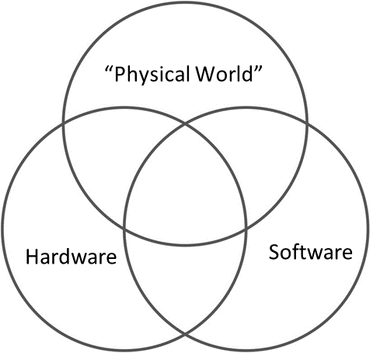
Interfacing Peripheral Devices to the Processor
Connecting to peripheral devices ➙ critical for embedded systems
Inputs: Sensors
Outputs: Actuators
Primarily, we need to know:
How do we set up (configure) peripheral devices?
How do we check the status of the devices?
How do we send commands to the devices?

Slide 11
How Does the CPU Communicate with Its Peripherals?

Slide 12

How Does the CPU Communicate with Its Peripherals?
X

Slide 13
How Does the CPU Communicate with Its Peripherals?
CPU
Bus
Bus
Register Memory
Bus
Bus
X
Peripheral

Slide 14
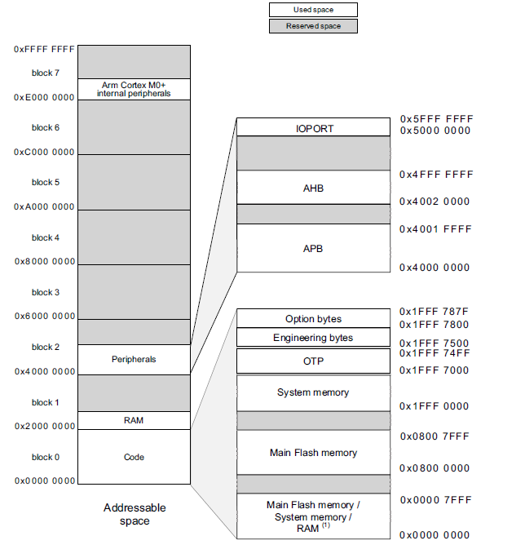
Memory Mapped I/O
Memory Mapped I/O
Peripheral registers are mapped in memory address space at specific locations
Standard load/store access

Slide 15
Memory Mapped I/O vs. Port Mapped I/O
Memory Mapped I/O
Peripheral registers are mapped in memory address space at specific locations
Standard load/store access
Port Mapped I/O
Port Mapped I/O
Peripheral registers are mapped to locations with their own space (separate from other memory)
Special instructions for access
May have limited addressing options

Slide 16
Memory Mapped I/O (MMIO)
16

Slide 17
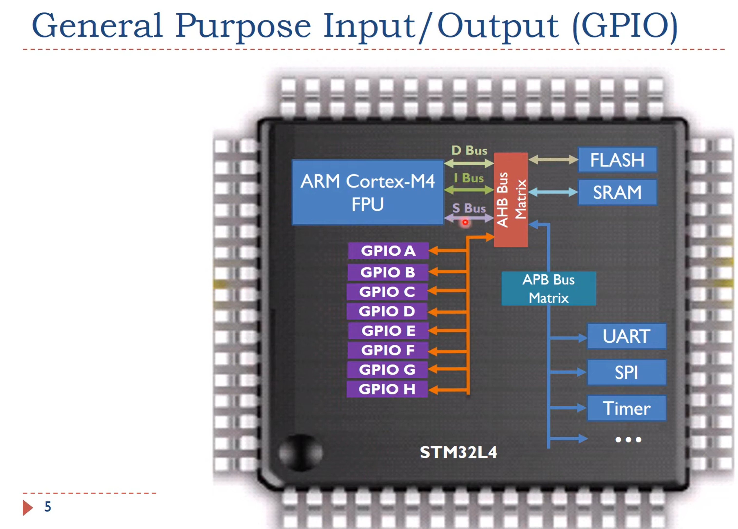

Slide 18
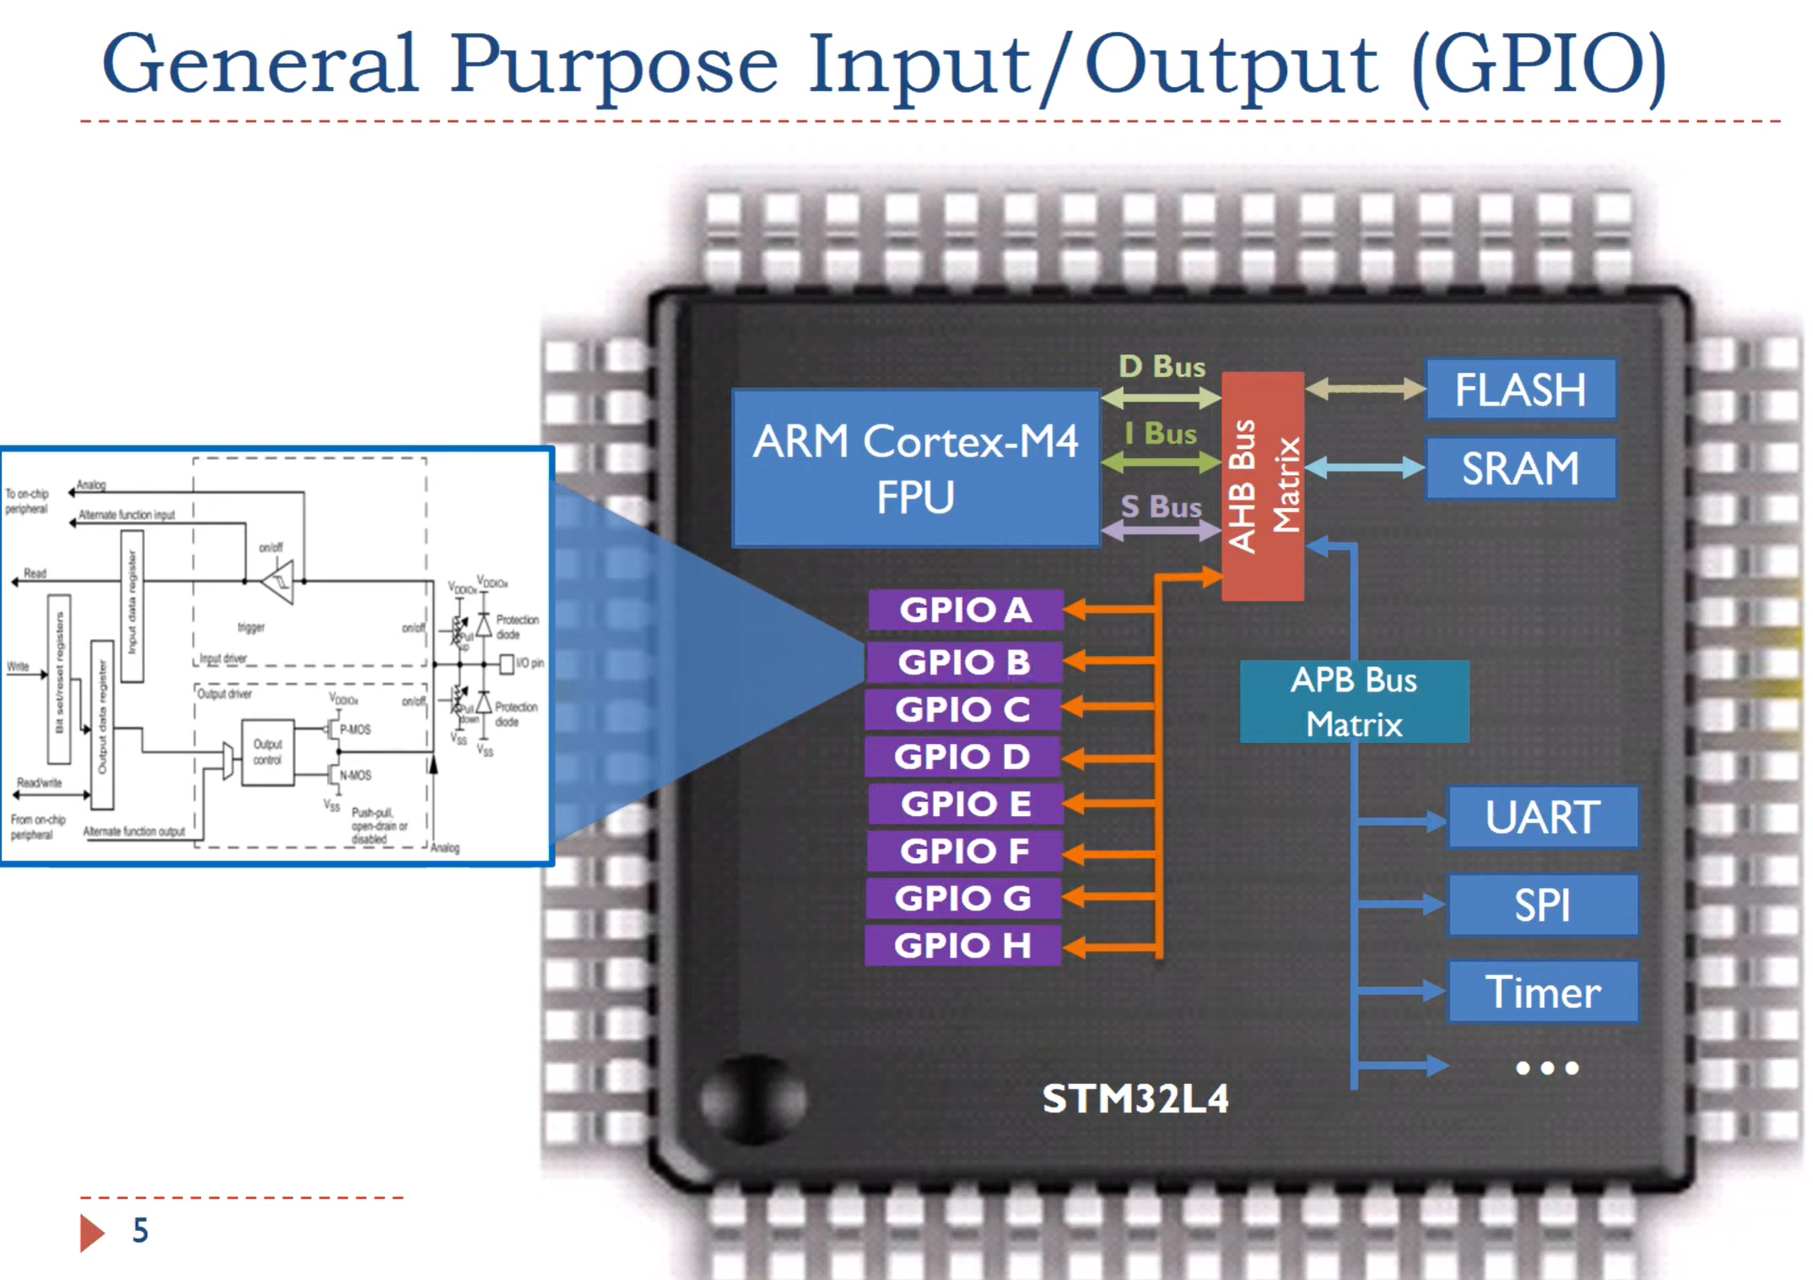

Slide 19
Digital Input/Output Ports Memory Mapped Registers (x = A, B, C…)
General Purpose Input/Output port MODE Registers (GPIOx_MODER)
General Purpose Input/Output port Output TYPE Register (GPIOx_OTYPER)
General Purpose Input/Output port Pull-Up/Pull-Down Register (GPIOx_PUPDR)
General Purpose Input/Output port Input Data Register (GPIOx_IDR)
General Purpose Input/Output port Output Data Register (GPIOx_ODR)

Slide 20
Digital Input/Output Ports Memory Mapped Registers (x = A, B, C…)
GPIO MODE Registers GPIOx_MODER Pin is input or output?
GPIO Output TYPE Register GPIOx_OTYPER Push-pull or open drain?
GPIO Pull-Up/Pull-Down Register GPIOx_PUPDR Pull-up/down resistor?
GPIO Input Data Register GPIOx_IDR Incoming data?
GPIO Output Data Register GPIOx_ODR Outgoing data?

Slide 21
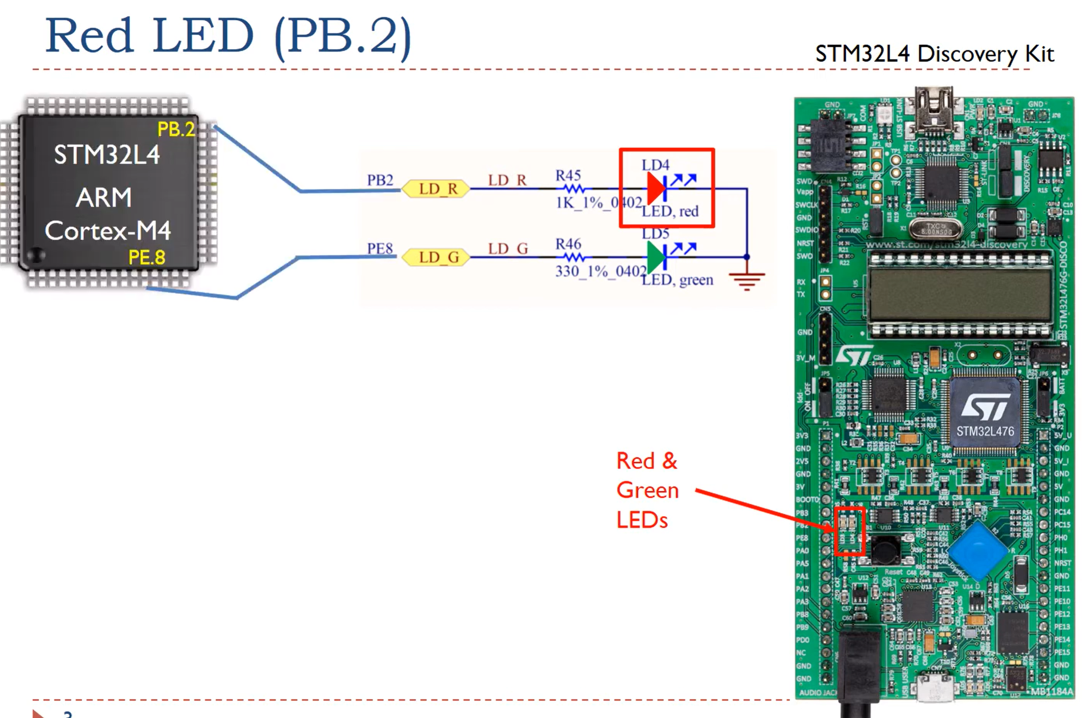

Slide 22
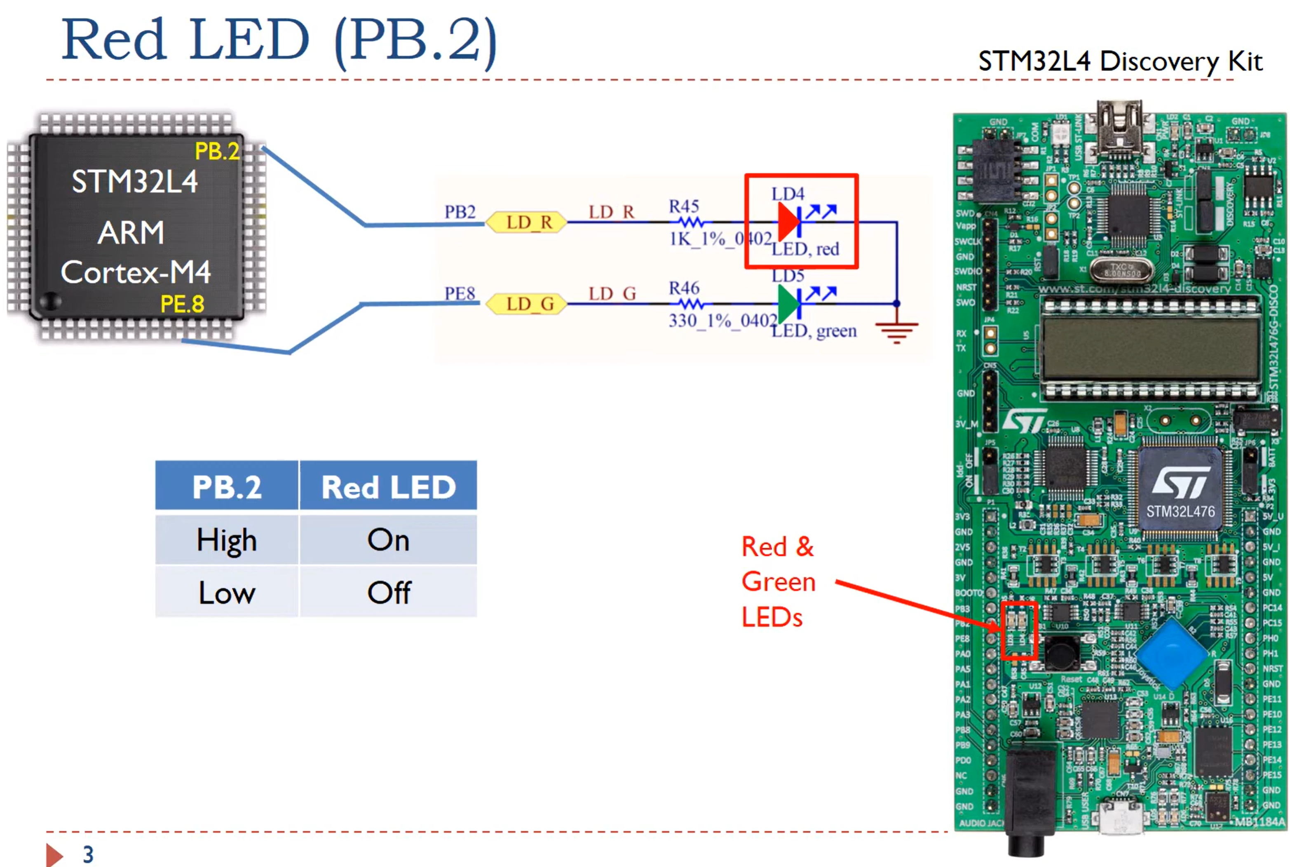

Slide 23
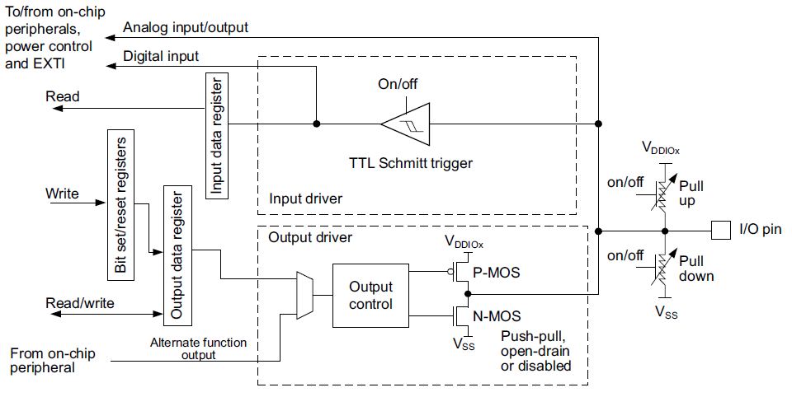
Example Memory Mapped I/O Peripheral Digital Input/Output Ports

Slide 24
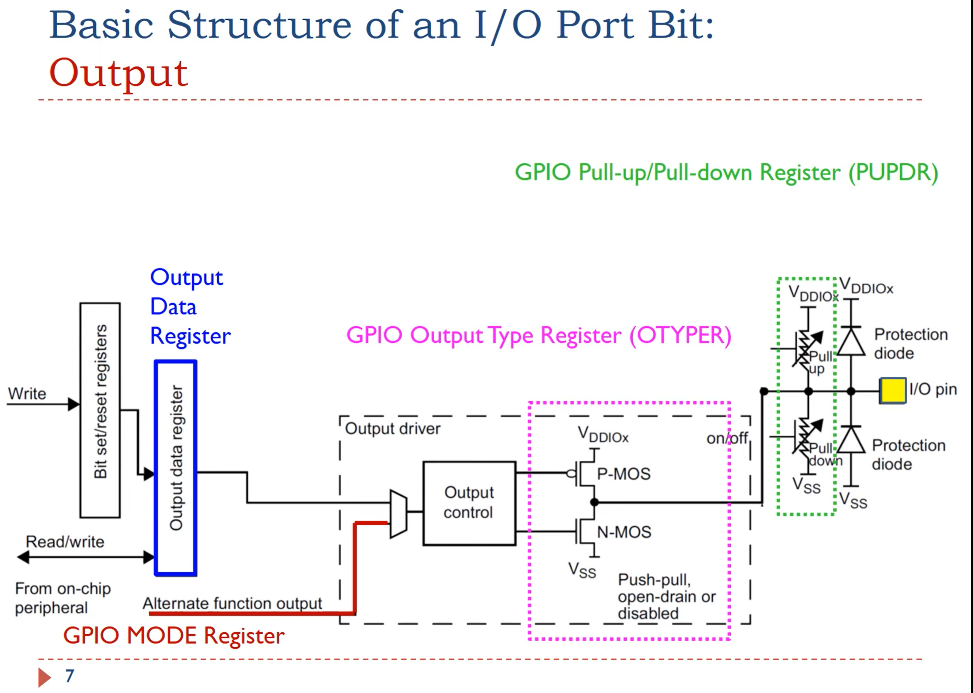

Slide 25
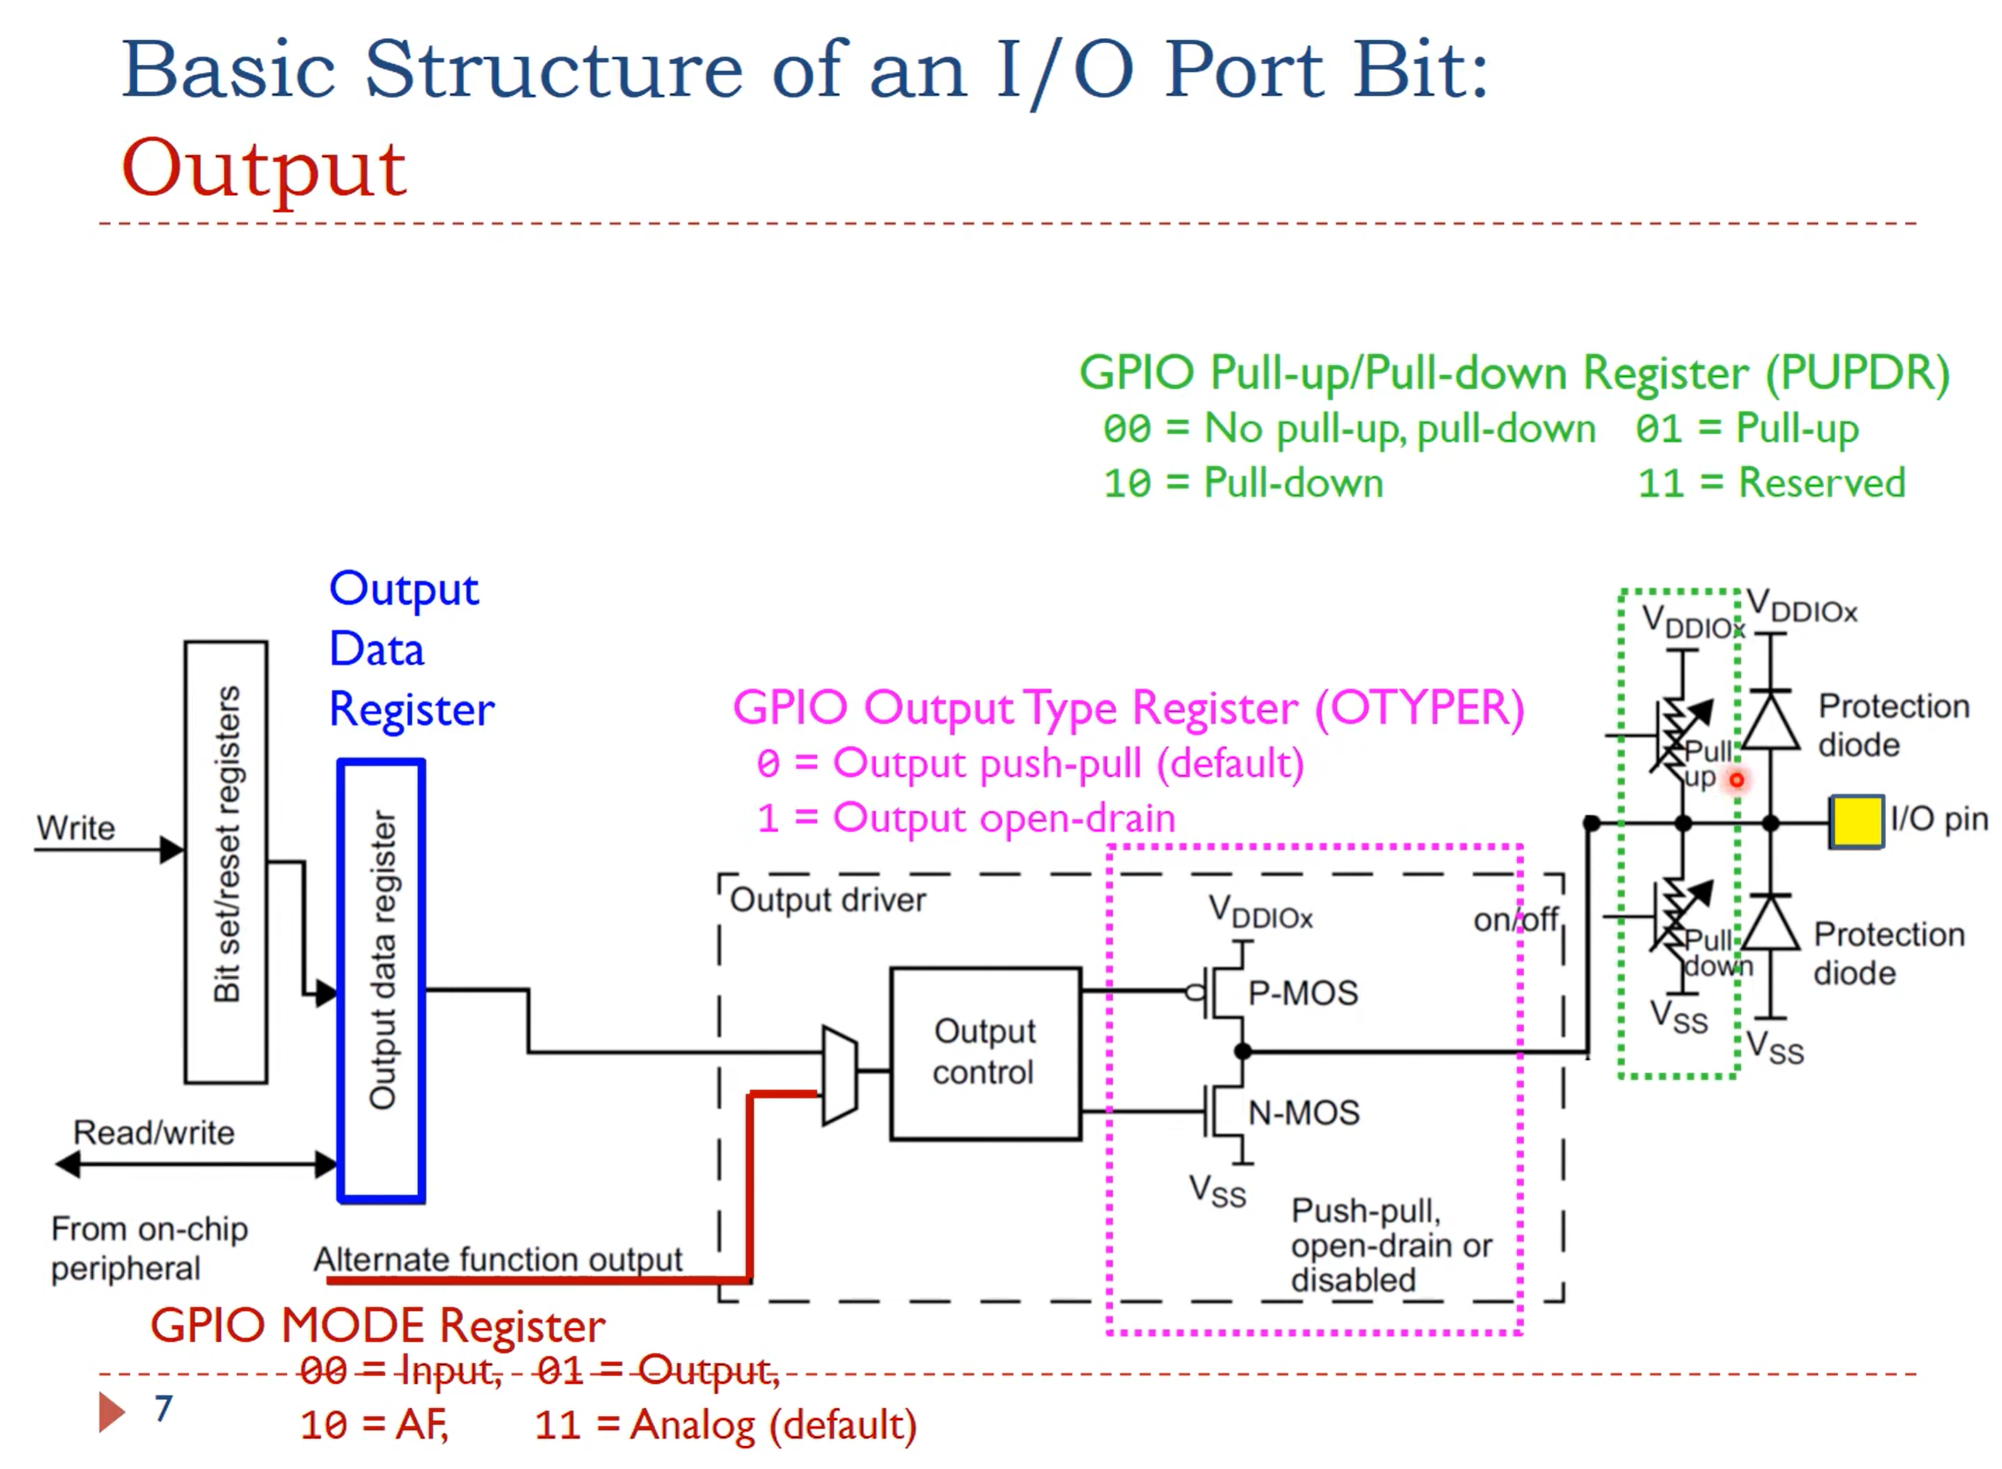

Slide 26
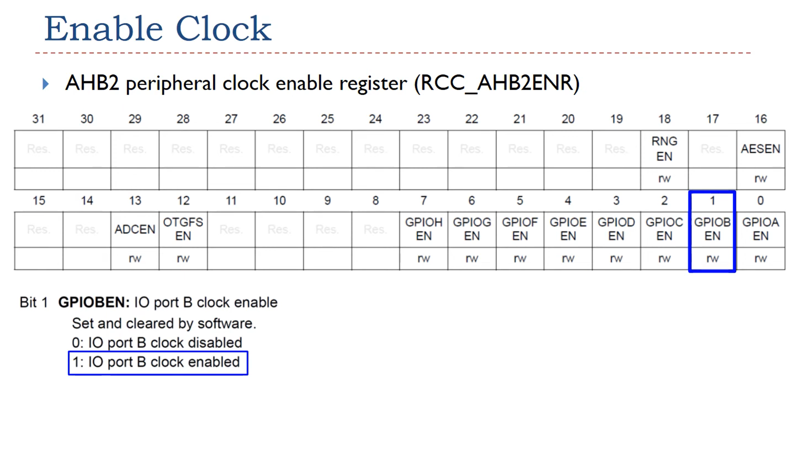

Slide 27
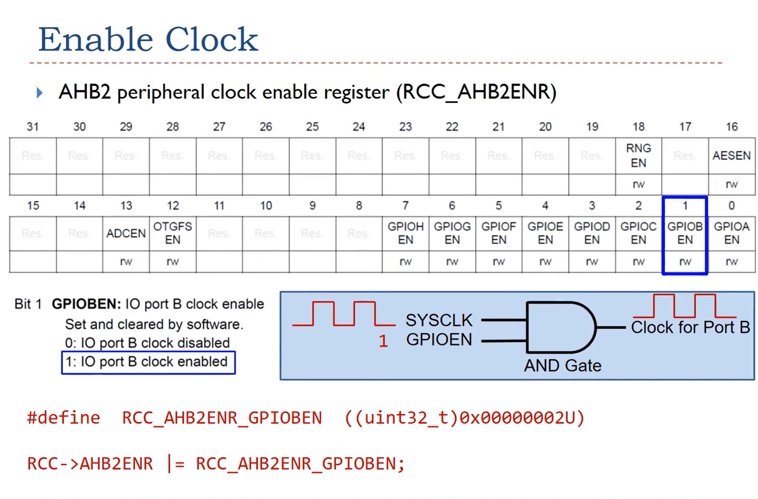

Slide 28
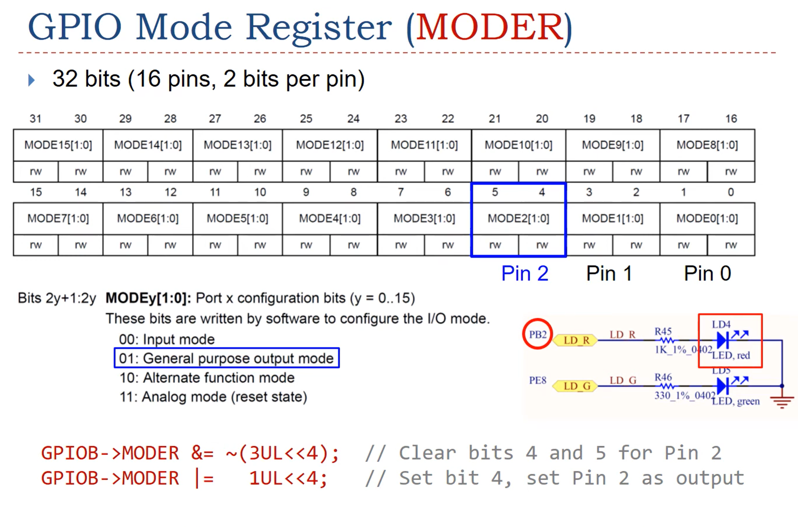

Slide 29
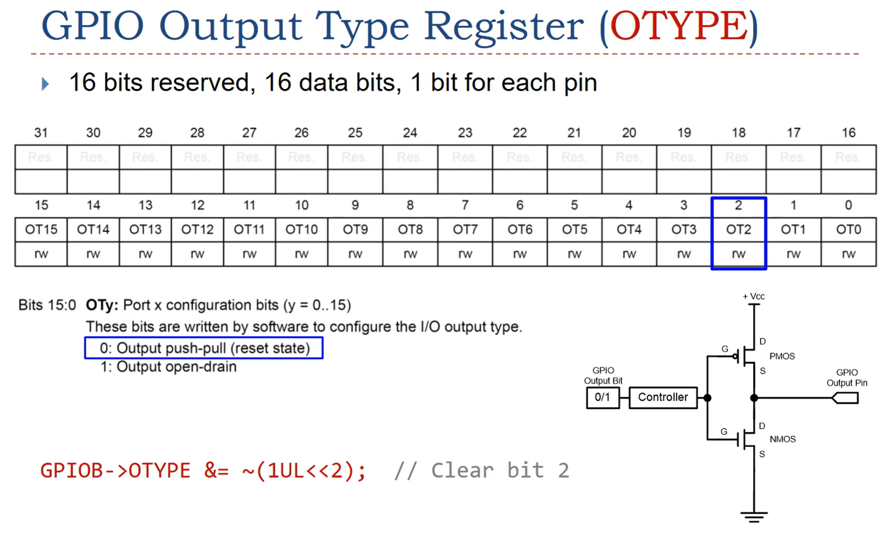

Slide 30
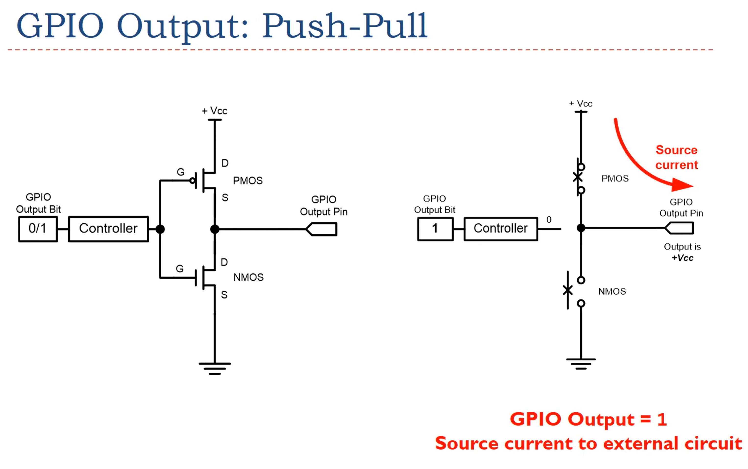

Slide 31
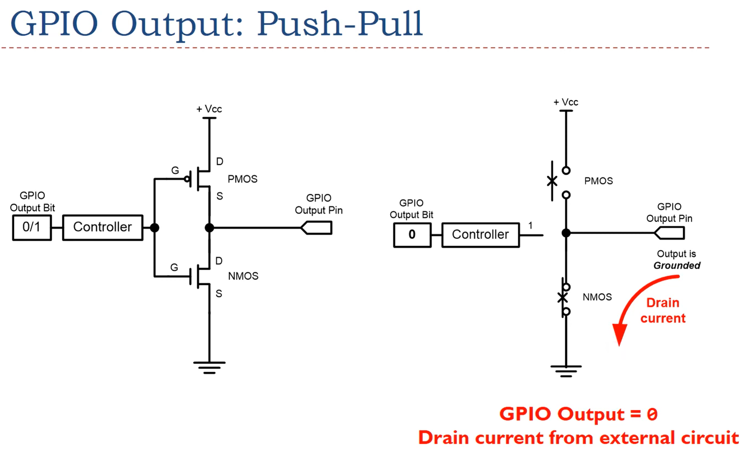

Slide 32
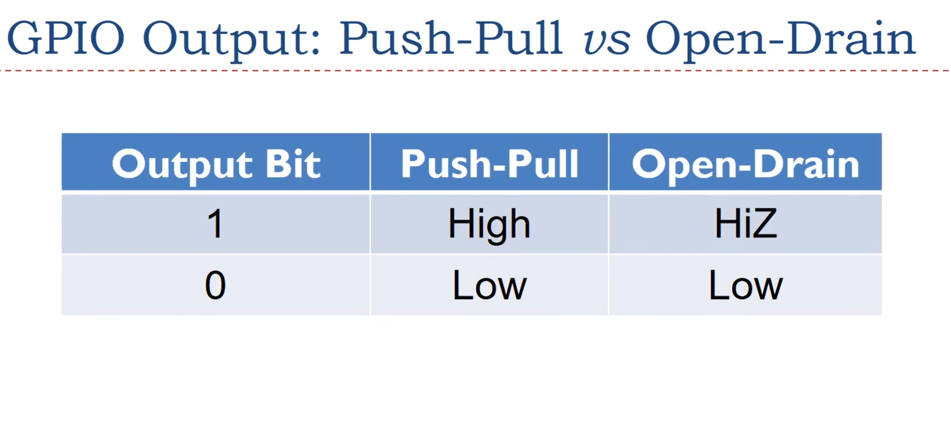

Slide 33
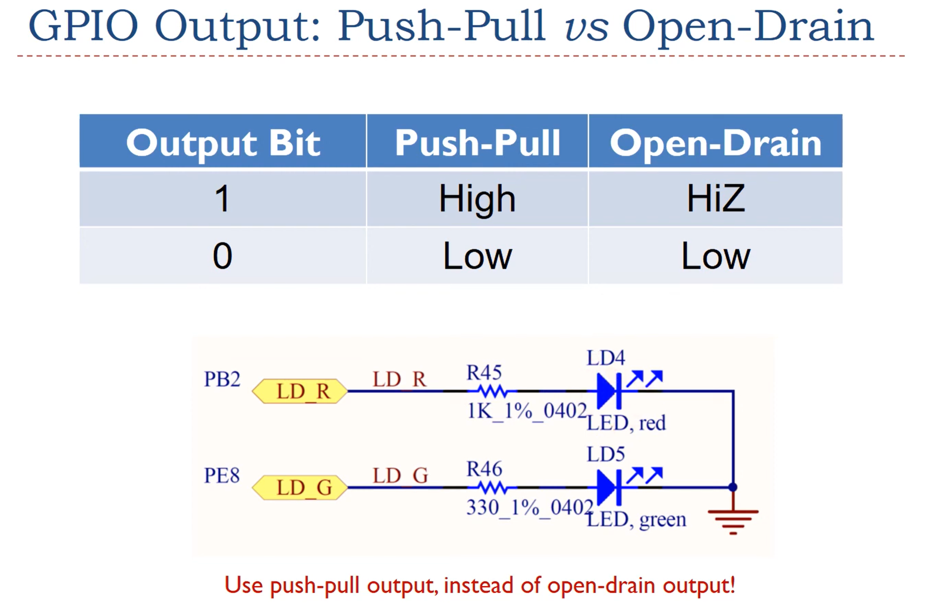

Slide 34
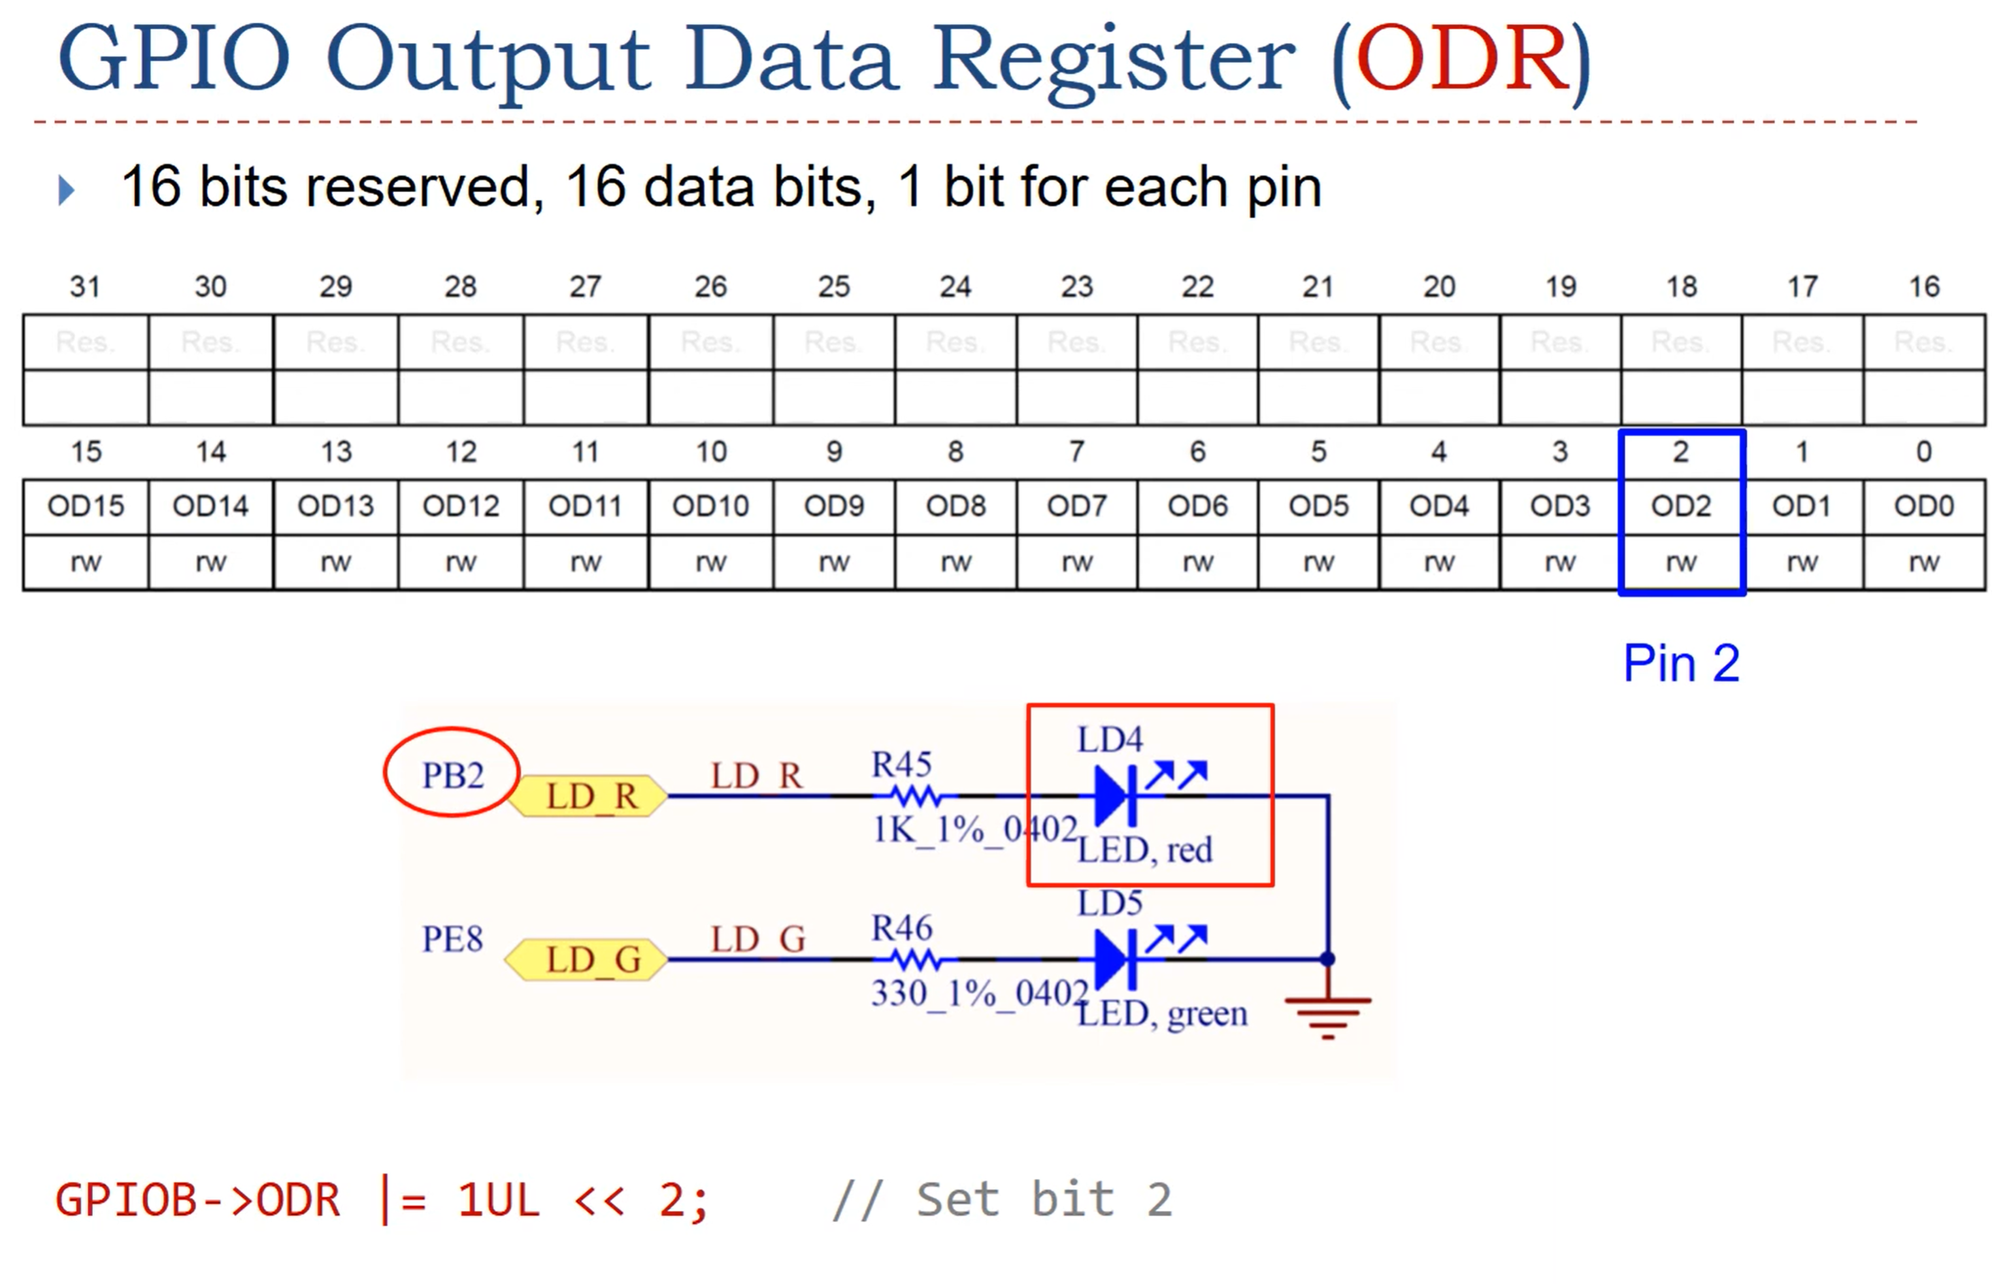

Slide 35
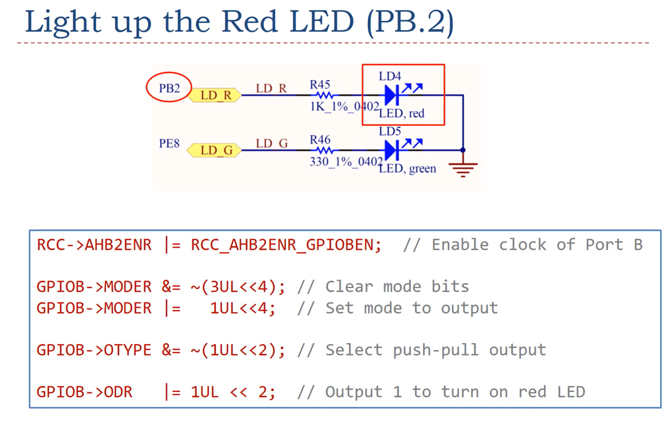

Slide 36
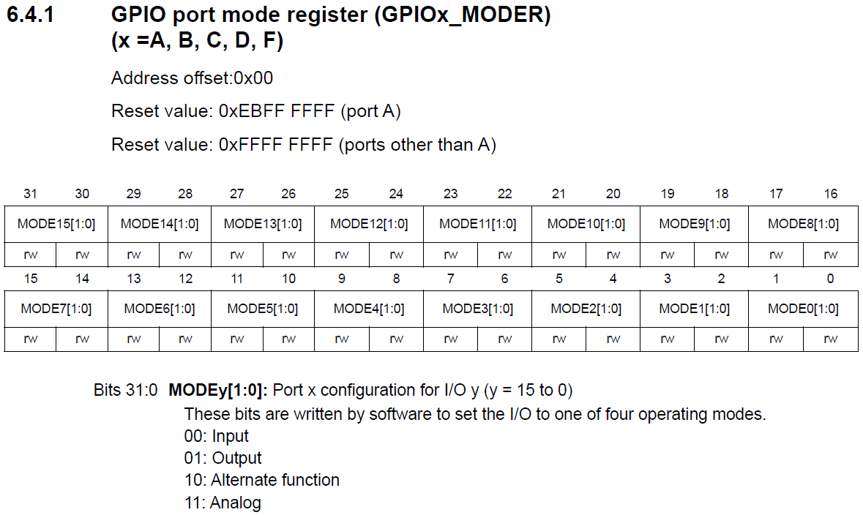
Name

Slide 37
Name
Location in Memory

Slide 38
Name
Location in Memory
Values automatically loaded into the
register after a reset

Slide 39
Name
Location in Memory
Values automatically loaded into the
register after a reset
Bit
assignments

Slide 40
Name
Location in Memory
Values automatically loaded into the
register after a reset
Bit
assignments
(r)eadable
(w)riteable

Slide 41
Name
Location in Memory
Values automatically loaded into the
register after a reset
Bit
assignments
(r)eadable
(w)riteable
What the bits in the register will communicate
to the peripheral

Slide 42
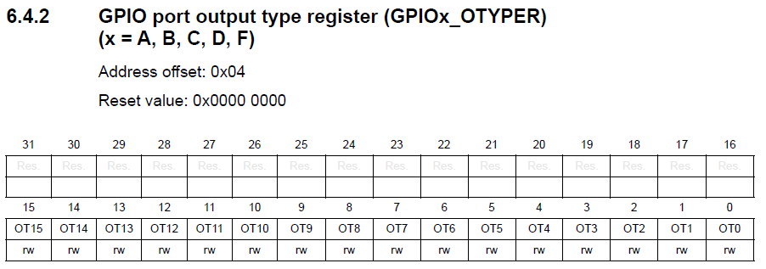
Name
Location in Memory
(r)eadable
(w)riteable
Values automatically loaded into the register after a reset
OT = Output Type

Slide 43

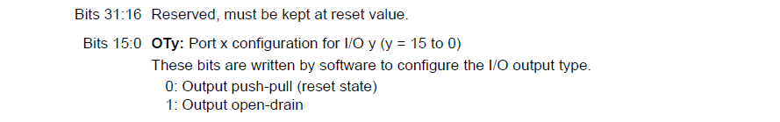
Name
Location in Memory
(r)eadable
(w)riteable
Values automatically loaded into the register after a reset
OT = Output Type

Slide 44
Name
Location in Memory
(r)eadable
(w)riteable
Values automatically loaded into the register after a reset
OT = Output Type

Slide 45
Name
Location in Memory
(r)eadable
(w)riteable
Values automatically loaded into the register after a reset
OT = Output Type
What the bits in the register will communicate to the peripheral

Slide 47
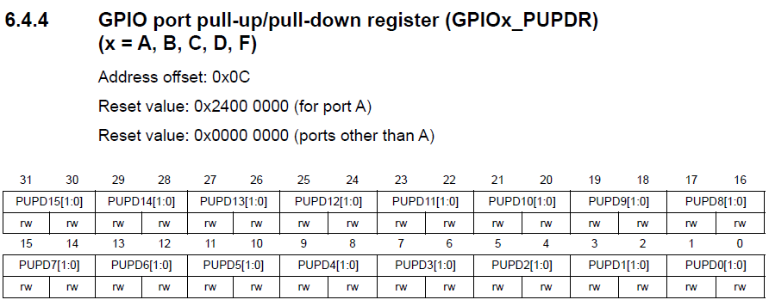
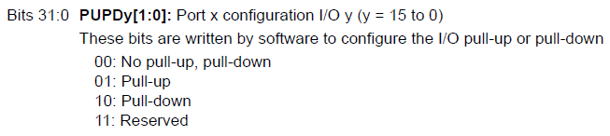

Slide 49
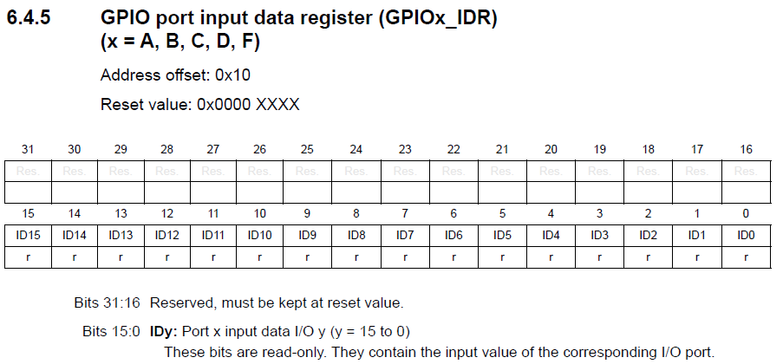
Note, bits 15..0 are not affected by reset
(r)eadable only
can not be written to

Slide 50
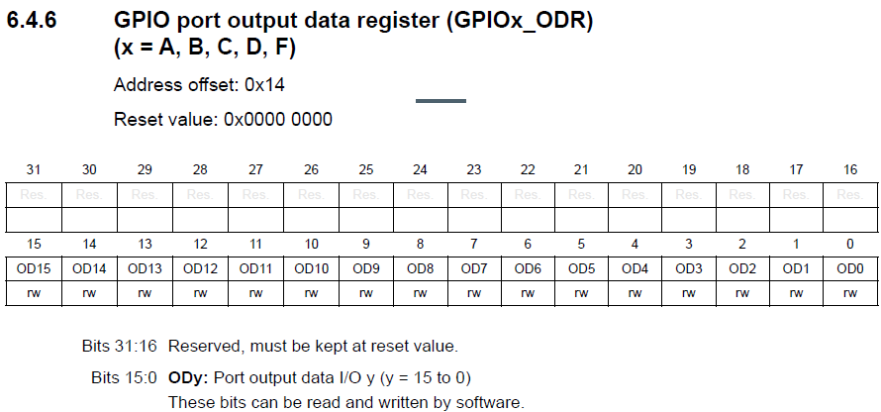
(r)eadable AND
(w)riteable

Slide 51
Access to Memory Mapped Inputs and Outputs (MMIO)
All communication with a peripheral must take place across the buses
Interface to peripheral must follow all the normal bus rules
Address bits are used to load/store data in the peripheral’s memory mapped registers
Data bus is tri-stated except when enabled
Control signals direct traffic
Decoder(s) in each peripheral
maps bits in the MM I/O registers
to HW functionality

Slide 52
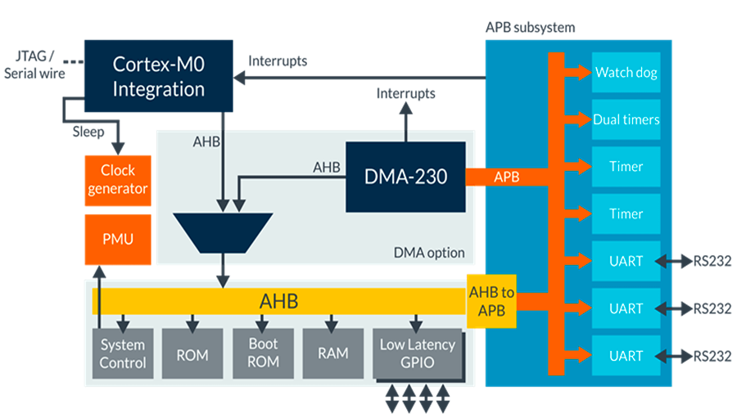
Cortex-M4 Bus Interface
Advanced Peripheral Bus (APB)
Advanced
High-performance
Bus (AHB)

Slide 53

Example – Writing to an External 7-Segment LED Display
The LED manufacturer specifies 8-bit values that can be written to display a character
The LED manufacturer provides a table describing the necessary value which corresponds to each character to be displayed, for example:
// LED character map
#define LEDcharP 0x0C
#define LEDcharH 0x09
#define LEDcharA 0x08
The “hardware” engineer will specify the memory address where the GPIO output register is mapped (for example 0x2020 0000)
The “software” engineer will write code to display a desired character (for example, the letter “P”)
LDR R0,=0x20200000
MOV R1,#0x0C
STRB R1,[R0]

Slide 54
Writing Code to Access MMIO Registers
Hard coding the address may pose problems in moving to a new board or microcontroller if the register address changes
LDR R0, =0x20200000
MOV R1, #0x0C
STRB R1, [R0]
Rather, use the EQU assembler directive
SSEG_BASE EQU 0x20200000 // Found in giant include file
LDR R0, =BASE

Slide 55
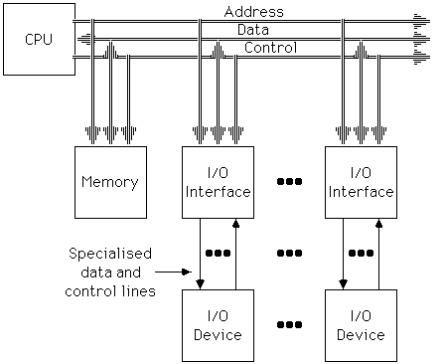


GPIO: General Purpose I/O
Your Nucleo board (and many such boards / microcontrollers) has about 20 GPIO pins
Each GPIO pin is individually driven / read
A GPIO pin is connected to the bus with an I/O interface
Takes care of addressing with an address decoder
Takes care of tri-state drivers
May do additional interfacing (pull-up resistors, ...)
THIS is a GPIO pin

Slide 56

LED: Light Emitting Diode
Semiconductor that emits photons (lights up) when current flows through
Polarized device (VANODE > VCATHODE)
Illuminates when a positive current flows from the anode to the cathode
Different colors available
Based on the energy (and voltage) required for electrons to cross the band gap
Used in Embedded Systems:
For status indicators
Remote control / communication (infra-red)
Segments in a 7-segment display
Lighting
Flat
Edge
Anode
Cathode

Slide 57
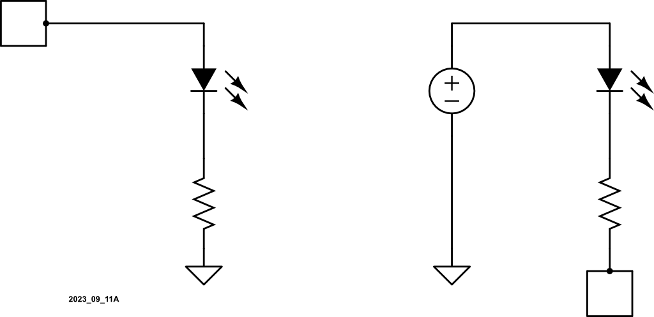
LEDs Can Be Connected to GPIO Pins Two Ways: “Active HI” or “Active LO”
V_{OUT} = HI = 5V
V_{OUT} = LO = 0V
D0
D0
LED
Is On
LED
Is Off
I_{LED} > 0A
I_{LED} = 0A

Slide 58
LEDs Can Be Connected to GPIO Pins Two Ways: “Active HI” or “Active LO”
LED
Is On
LED
Is Off
+5V
+5V
I_{LED} > 0A
I_{LED} = 0A
D0
V_{OUT} = LO = 0V
D0
V_{OUT} = HI = 5V

Slide 59
LEDs Can Be Connected to GPIO Pins Two Ways: “Active HI” or “Active LO”
Usually works better
V_{OUT} = HI = 5V
D0
Digital GPIO
Can Source
~ 1mA
LED
Is On
LED
Is On
+5V
I_{LED} > 0A
I_{LED} > 0A
Digital GPIO
Can Sink ~ 10mA
D0
V_{OUT} = LO = 0V

Slide 60
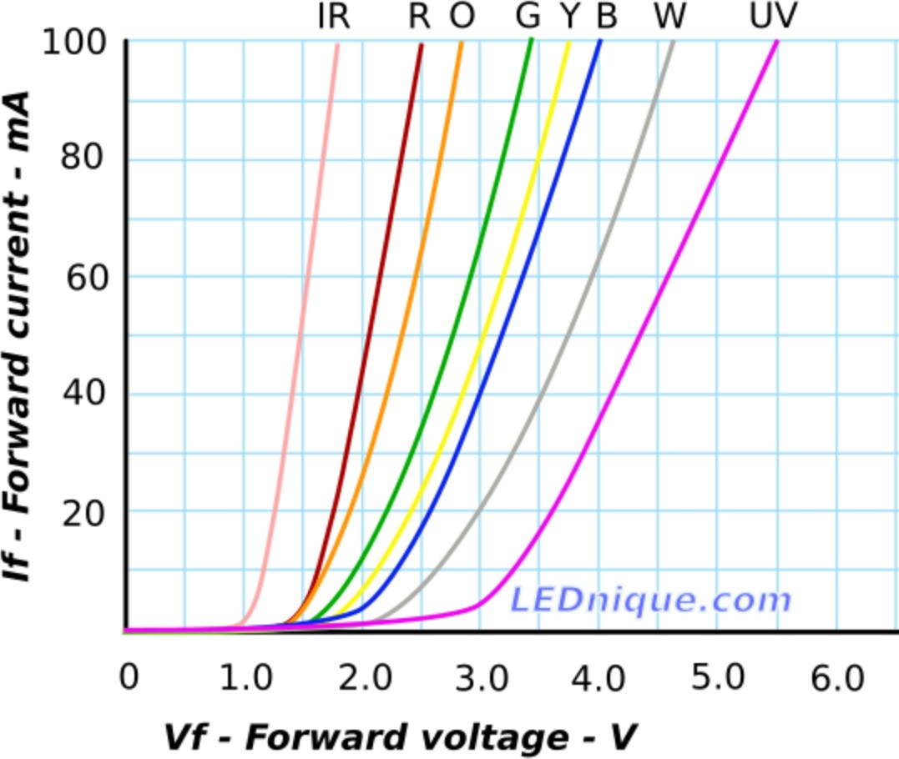
LED Current Limiting Resistor
LEDs turn on when for any time I_{LED} > 0A
If I_{LED} is too small, the illumination may not be visible
If I_{LED} is too big, the LED can “burn out”
Use an appropriately sized resistor to ensure the LED current (and its visibility) are appropriate.

Slide 61
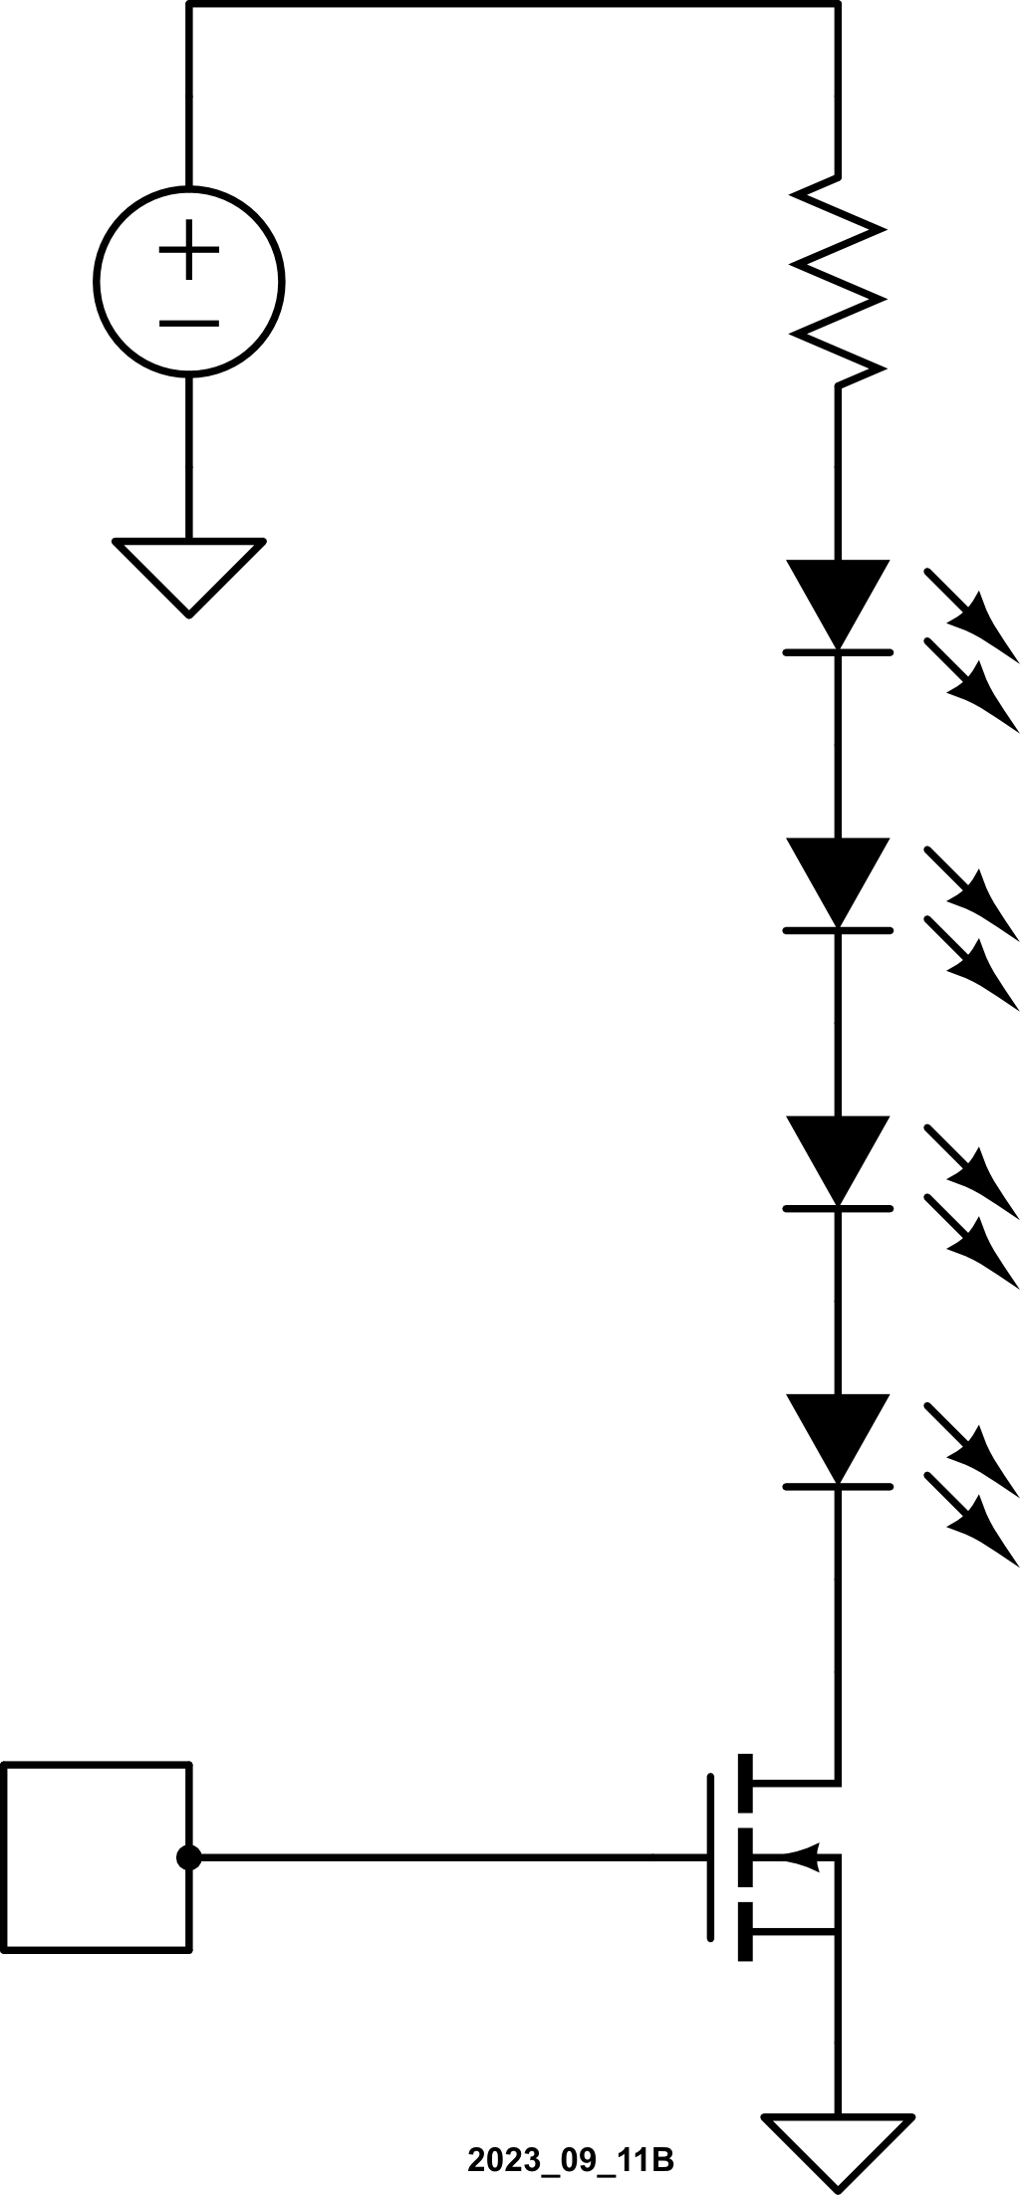
Improving LED Current Drive
Use a GPIO to drive a transistor to increase the current flowing through one or more LEDs
V_{SUPPLY}
D0
Q1

Slide 62
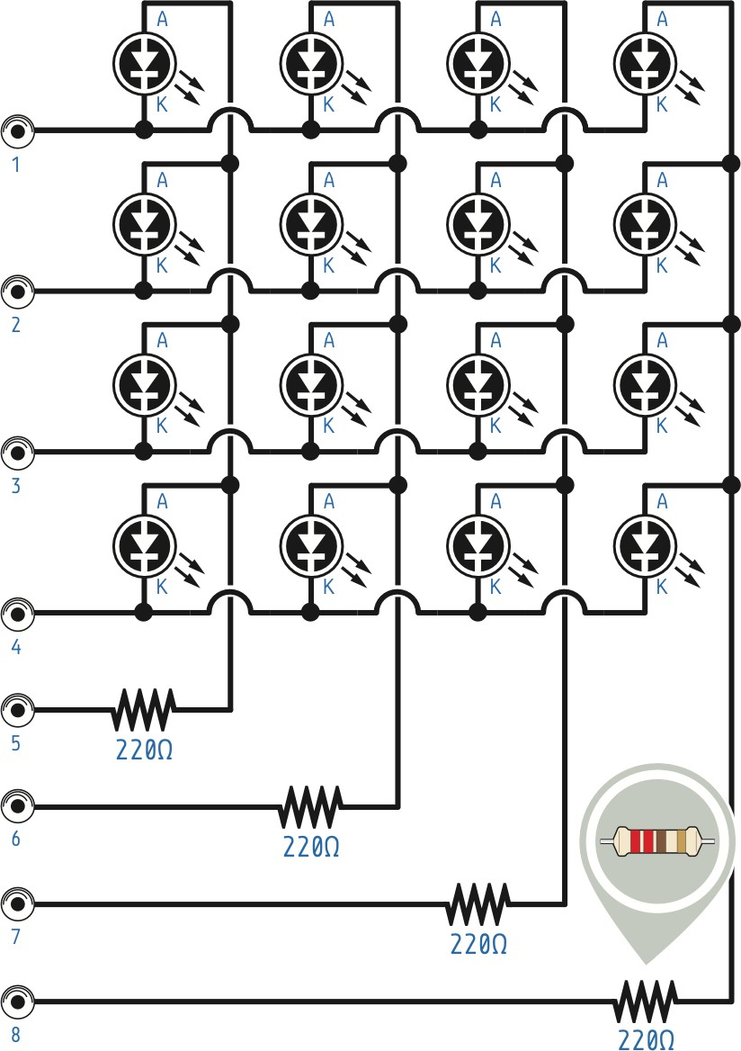
Controlling a Matrix of LEDs
PIN1
A matrix configuration reduces the number of GPIO pins required to drive multiple LEDs
For example: Turn on the top left LED
ROW GPIO PIN1 = 0V (enables LED Row1) ROW GPIO PIN2 = PIN3 = PIN4 = 5VROW ROW GPIO (disables LED Rows 2, 3, and 4)
COLUMN GPIO PIN5 = 5V (enables Column1) COLUMN GPIO PIN6 = PIN7 = PIN8 = 0V COLUMN GPIO (disables Columns 2, 3, and 4)
Quickly toggle multiple LEDs to see them all on at the same time (persistence of vision)
PIN2
PIN3
PIN4
PIN5
PIN6
PIN7
PIN8

Slide 63
Controlling a Matrix of LEDs
0V=PIN1
A matrix configuration reduces the number of GPIO pins required to drive multiple LEDs
For example: Turn on the top left LED
ROW GPIO PIN1 = 0V (enables LED Row1) ROW GPIO PIN2 = PIN3 = PIN4 = 5VROW ROW GPIO (disables LED Rows 2, 3, and 4)
COLUMN GPIO PIN5 = 5V (enables Column1) COLUMN GPIO PIN6 = PIN7 = PIN8 = 0V COLUMN GPIO (disables Columns 2, 3, and 4)
Quickly toggle multiple LEDs to see them all on at the same time (persistence of vision)
PIN2
PIN3
PIN4
5V=PIN5
PIN6
PIN7
PIN8

Slide 64
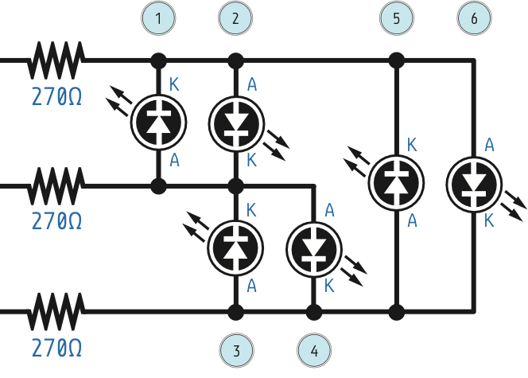
Advanced Technique: "Charlieplexing" GPIO = HI or LO or “Tristated” (disconnected)
GPIO outputs can be HI, LO, or Tristated (disconnected)
With 3 possible states, we can dramatically increase the number of LEDs driven with a given number of GPIO
To illuminate LED1: PIN1 = 0V PIN2 = 5V PIN3 = Tristated (disconnected)
0V=PIN1
5V=PIN2
Tri=PIN3

Slide 65
Advanced Technique: "Charlieplexing" GPIO = HI or LO or “Tristated” (disconnected)
GPIO outputs can be HI, LO, or Tristated (disconnected)
With 3 possible states, we can dramatically increase the number of LEDs driven with a given number of GPIO
To illuminate LED1: PIN1 = 0V PIN2 = 5V PIN3 = Tristated (disconnected)
0V=PIN1
5V=PIN2
0A
Tri=PIN3
65

Slide 66
Advanced Technique: "Charlieplexing" GPIO = HI or LO or “Tristated” (disconnected)
GPIO outputs can be HI, LO, or Tristated (disconnected)
With 3 possible states, we can dramatically increase the number of LEDs driven with a given number of GPIO
To illuminate LED1: PIN1 = 0V PIN2 = 5V PIN3 = Tristated (disconnected)
0V=PIN1
5V=PIN2
0A
Tri=PIN3
66

Slide 67
Advanced Technique: "Charlieplexing" GPIO = HI or LO or “Tristated” (disconnected)
GPIO outputs can be HI, LO, or Tristated (disconnected)
With 3 possible states, we can dramatically increase the number of LEDs driven with a given number of GPIO
To illuminate LED1: PIN1 = 0V PIN2 = 5V PIN3 = Tristated (disconnected)
0V=PIN1
5V=PIN2
0A
Tri=PIN3
67

Slide 68
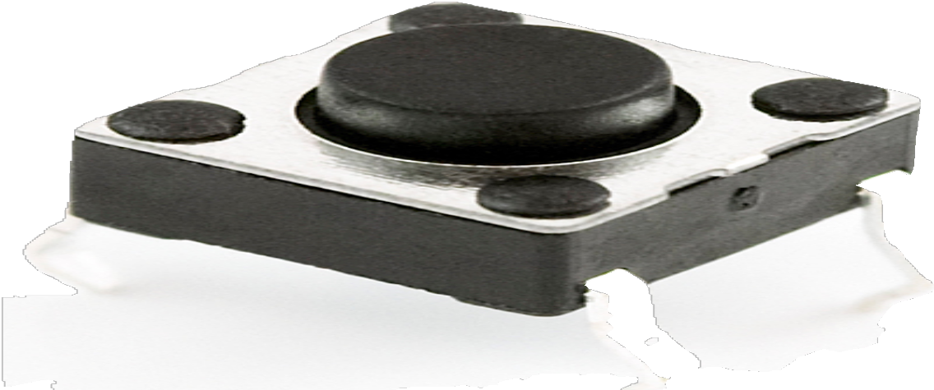
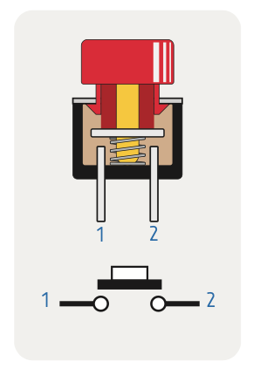
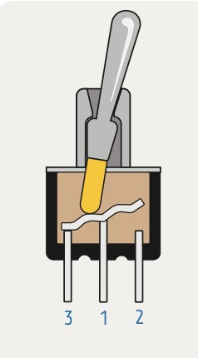
Buttons and Switches
Buttons: Momentary Connection
Switches: Maintained Connection
68

Slide 69
Contact Terminology: Normal, Poles and Throws
SPST-NO
SP: One circuit
ST: Open or closed
SPST-NC
A switch might be normally open (NO) or normally closed/connected (NC) to specify the default state
Poles: an electrically separate connection
Each pole is a separate circuit, a separate connection
Throw: separate wiring paths (other than "open") that the switch can adopt
Single throw: Switch is open or closed

Slide 70
Contact Terminology: Normal, Poles and Throws
SPST-NO
SP: One circuit
ST: Open or closed
SPST-NC
A switch might be normally open (NO) or normally closed/connected (NC) to specify the default state
Poles: an electrically separate connection
Each pole is a separate circuit, a separate connection
Throw: separate wiring paths (other than "open") that the switch can adopt
Single throw: Switch is open or closed
Double throw: Switch is connected to one side or connected to the other side
A
SP: One circuit
DT: A or B
SPDT
B

Slide 71
Contact Terminology: Normal, Poles and Throws
SPST-NO
SP: One circuit
ST: Open or closed
SPST-NC
A switch might be normally open (NO) or normally closed/connected (NC) to specify the default state
Poles: an electrically separate connection
Each pole is a separate circuit, a separate connection
Throw: separate wiring paths (other than "open") that the switch can adopt
Single throw: Switch is open or closed
Double throw: Switch is connected to one side or connected to the other side
A
SP: One circuit
DT: A or B
SPDT
B
DP: Two circuits
ST: Open or closed
DPST
A
B
SP: Two circuits
DT: A or B AND
C or D
DPDT
C
D

Slide 72
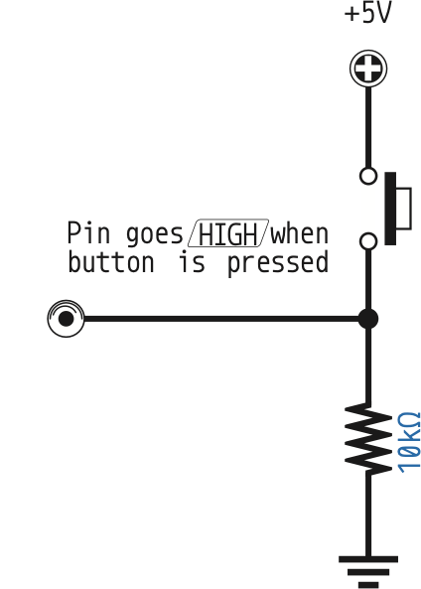
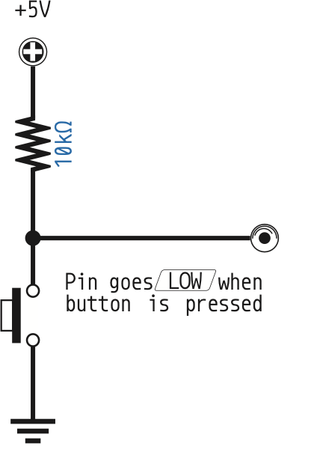
Connecting to a Microcontroller
The switch connects to V_{SUPPLY} or GND to drive a 1 or 0 to the GPIO
Pin goes HI when
button is pressed
Digital
Input
Digital
Input
Pin goes LO when
button is pressed

Slide 73
Connecting to a Microcontroller
The switch connects to V_{SUPPLY} or GND to drive a 1 or 0 to the GPIO
What happens if the switch is open?
Pin goes HI when
button is pressed
Digital
Input
Digital
Input
Pin goes LO when
button is pressed

Slide 74
Connecting to a Microcontroller
The switch connects to V_{SUPPLY} or GND to drive a 1 or 0 to the GPIO
What happens if the switch is open?
It “floats” to an indeterminate value
Pin goes HI when
button is pressed
Digital
Input
Digital
Input
Pin goes LO when
button is pressed

Slide 75
Connecting to a Microcontroller
The switch connects to V_{SUPPLY} or GND to drive a 1 or 0 to the GPIO
What happens if the switch is open?
It “floats” to an indeterminate value
Use a pull-up or pull-down resistor to drive a voltage when switch is open
Pin goes HI when
button is pressed
Digital
Input
Digital
Input
Pin goes LO when
button is pressed

Slide 76
Connecting to a Microcontroller
500μA
The switch connects to V_{SUPPLY} or GND to drive a 1 or 0 to the GPIO
What happens if the switch is open?
It “floats” to an indeterminate value
Use a pull-up or pull-down resistor to drive a voltage when switch is open
Large resistance so you don't waste power when not active
Pin goes HI when
button is pressed
Digital
Input
Digital
Input
Pin goes LO when
button is pressed
500μA

Slide 77
Internal GPIO Pull-Up (and Pull-Down) Resistors

Slide 79
Buttons and Switches
Buttons: Momentary Connection
Switches: Maintained Connection
79

Slide 80
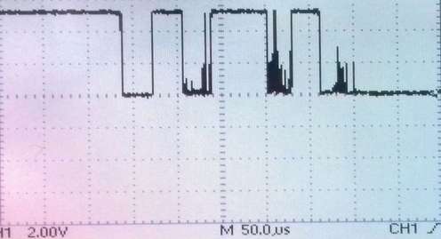
Switch Bounce
Switches and buttons go can “bounce” when changing states
Up to 10ms (or more) when the connection is unstable
Microcontroller may count the bounces as multiple events

Slide 81
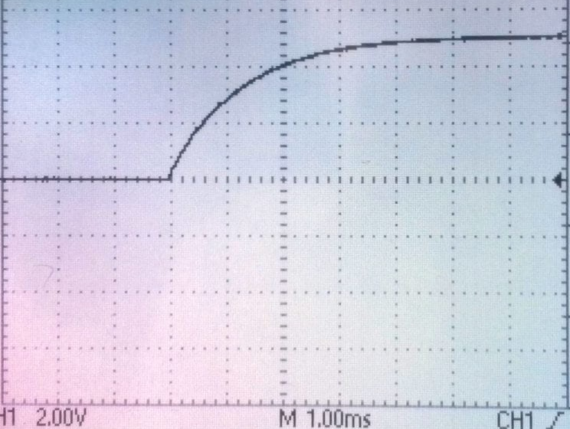
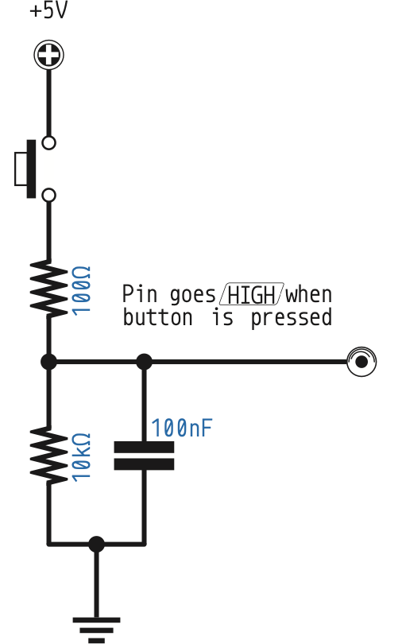
Switch Bounce
Between HI and LO
Switches and buttons go can “bounce” when changing states
Up to 10ms (or more) when the connection is unstable
Microcontroller may count the bounces as multiple events
Solutions:
Solution 1A, HW: Use a low-pass filter (capacitor) with the button
Pin goes HI when
button is pressed
Digital
Input

Slide 82
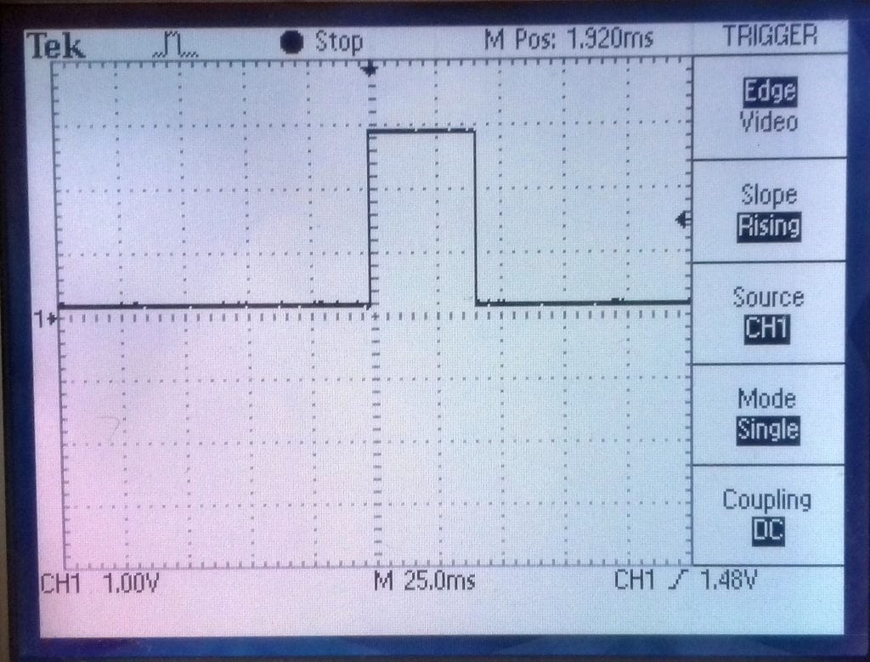
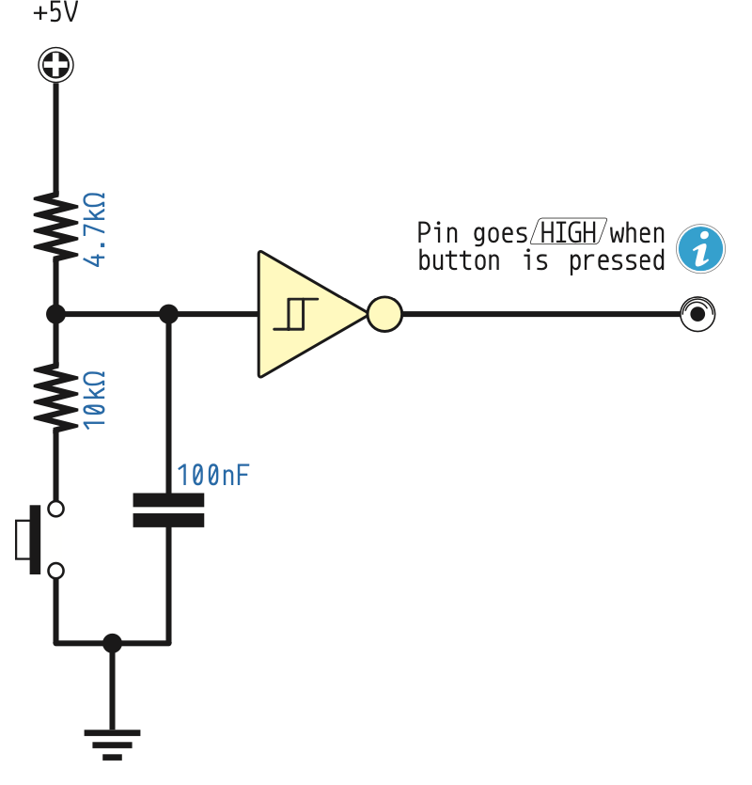
Switch Bounce
Output of Schmitt Trigger
Has Hysteresis
Switches and buttons go can “bounce” when changing states
Up to 10ms (or more) when the connection is unstable
Microcontroller may count the bounces as multiple events
Solutions:
Solution 1A, HW: Use a low-pass filter (capacitor) with the button
Solution 1B, HW: Use a low-pass filter (capacitor) with a Schmitt trigger
Pin goes HI when
button is pressed
Digital
Input

Slide 83
Switch Bounce
Switches and buttons go can “bounce” when changing states
Up to 10ms (or more) when the connection is unstable
Microcontroller may count the bounces as multiple events
Solutions:
Solution 1A, HW: Use a low-pass filter (capacitor) with the button
Solution 1B, HW: Use a low-pass filter (capacitor) with a Schmitt trigger
Solution 2, HW: Use an SR-Latch with the button
SR Latch
S | R | Q (i.e. output)
0 | 0 | Hold
0 | 1 | 0
1 | 0 | 1
1 | 1 | Don't do this

Slide 84
Switch Bounce
Switches and buttons go can “bounce” when changing states
Up to 10ms (or more) when the connection is unstable
Microcontroller may count the bounces as multiple events
Solutions:
Solution 1A, HW: Use a low-pass filter (capacitor) with the button
Solution 1B, HW: Use a low-pass filter (capacitor) with a Schmitt trigger
Solution 2, HW: Use an SR-Latch with the button
Solution 3, SW: Wait 10+ ms after detecting the change and sample again (slower = more protection)

Slide 85
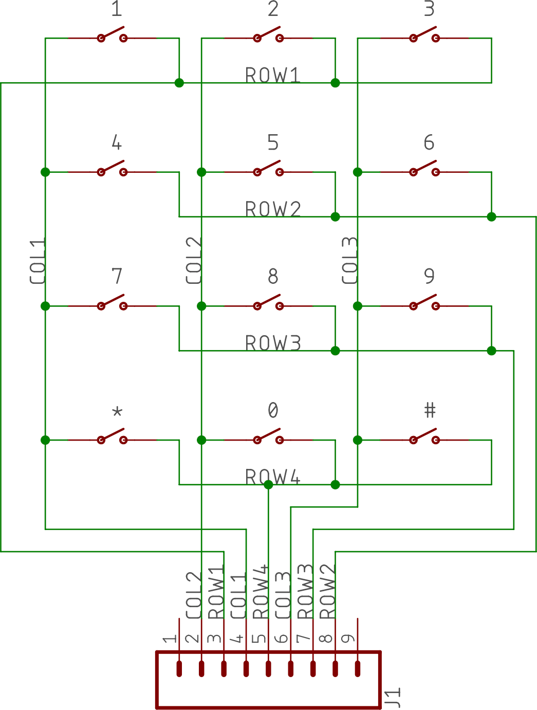
Keypads (Lots of Buttons)
Buttons are formed into a matrix to reduce GPIO connections
3x4 keypad
Only 7 GPIO pins
One for each row
One for each column

Slide 86
Activate Rows and Test Columns
GND
Set one Column 1 to GND, others are 5V or open

Slide 87
Activate Rows and Test Columns
GND
Set one Column 1 to GND, others are 5V or open
Read Row1, Row2, Row3, and Row4 to see if GND
Row 1 = GND, then “1” is pressed

Slide 88
Activate Rows and Test Columns
Set one Column 1 to GND, others are 5V or open
Read Row1, Row2, Row3, and Row4 to see if GND
Row 1 = GND, then “1” is pressed
Row 2 = GND, then “4” is pressed
Row 3 = GND, then “7” is pressed
Row 4 = GND, then “*” is pressed

Slide 89
Activate Rows and Test Columns
Set one Column 1 to GND, others are 5V or open
Read Row1, Row2, Row3, and Row4 to see if GND
Row 1 = GND, then “1” is pressed
Row 2 = GND, then “4” is pressed
Row 3 = GND, then “7” is pressed
Row 4 = GND, then “*” is pressed
Update a new Column to GND and repeat

Slide 90

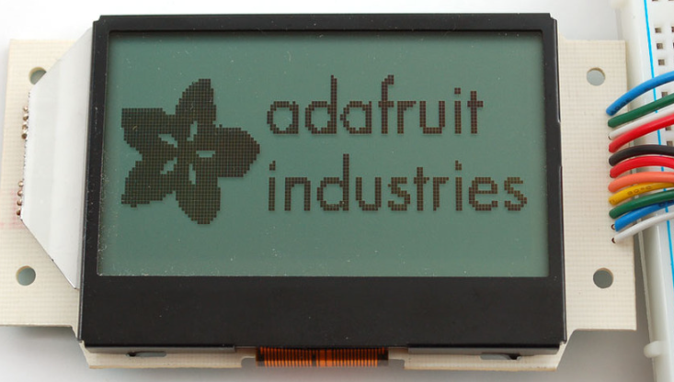
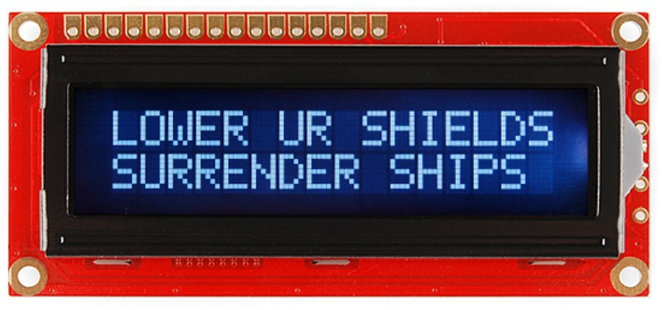
Liquid Crystal Display (LCD)

Slide 91
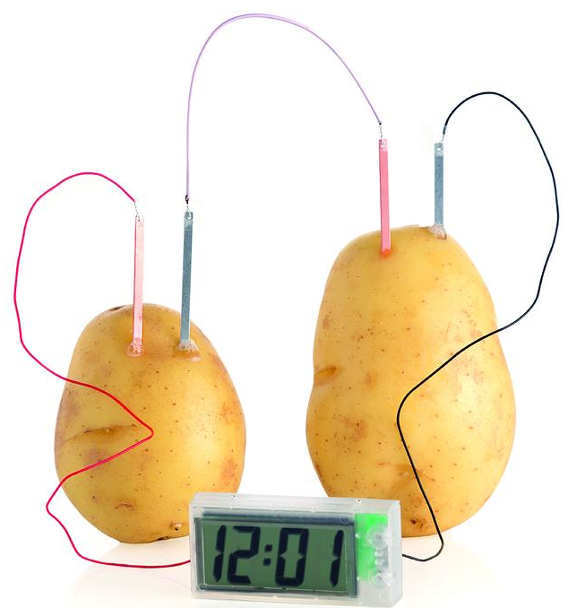
Using the Hitachi HD44780 LCD Driver
Extremely common
Alphanumeric displays
1,2,4,8 rows by 16, 32, 40, 80 columns (1 character per position)
Handles font data: ASCII, Japanese Kana, some symbols
Backlight system
Selectable 4 or 8-bit data bus
Very, very, very low power without a backlight

Slide 92
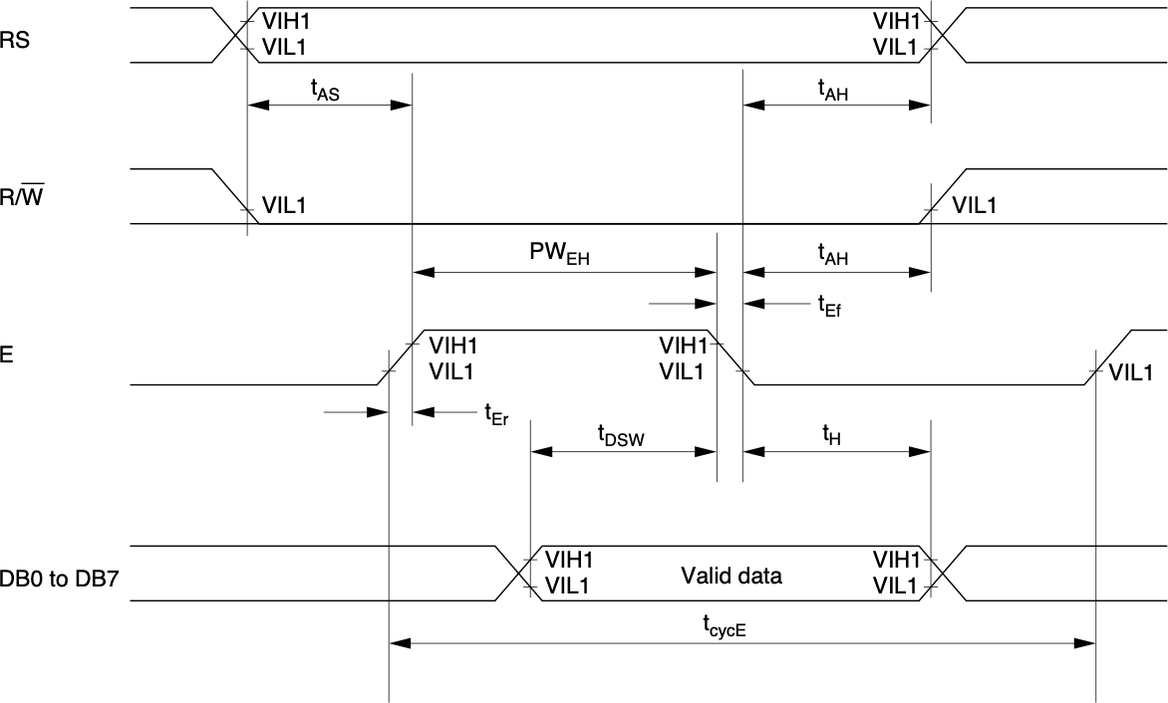
Using the Hitachi HD44780 LCD Driver
RS (Register Select)
RS = LO to send Commands
RS = HI to send Data
R/W (Read or Write)
Pull to GND to Write data
E (Clock Enable on falling edge)
Data bus is 4-bit or 8-bits
Other pins for contrast and backlighting

Slide 93
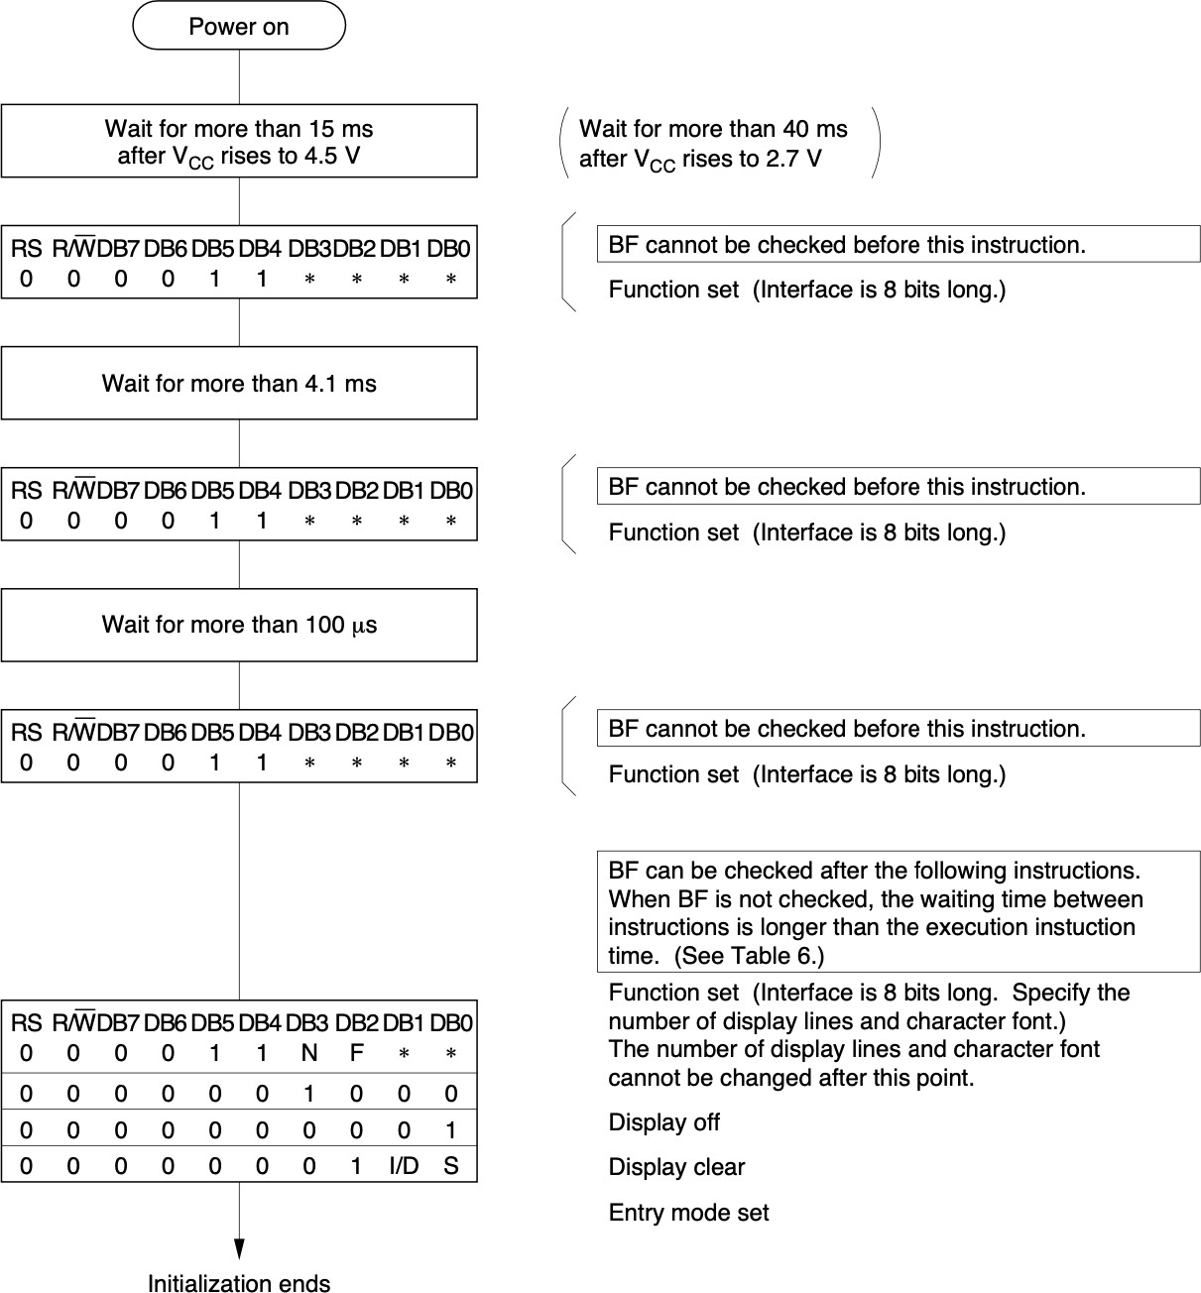
Initializing the Hitachi HD44780 LCD Driver
After power-on, several commands get written to initialize the device
Several timed waits are required to allow the controller to do its power-on work

Slide 94
An Interface to the HD44780 LCD Driver
Using the HD44780 uses 7 / 11 pins
Can use a “boosterpack” between your microcontroller and the HD44780
TI's PCF8574 (I2C)
Microchip's MCP23017 (I2C)
Microchip's MCP23S17 (SPI)
“Free” with a serial communication port
Non-insignificant amount of software
I2C
Serial Port

Slide 95
Overview of Lecture
What Are Peripherals?
Memory Mapped I/O
volatile
General Purpose Inputs/Outputs
Light Emitting Diodes (LEDs)
Switches
Keypads
Liquid Crystal Displays (LCDs)

